Slide 1

ACADEMIC AND THESIS WRITING WORKSHOPS
TOWNSVILLE AND CAIRNS SERIES 1 2019
SESSION 2: LITERATURE REVIEWS
CONVENOR: ASSOCIATE PROFESSOR LIZ TYNAN
JCU GRADUATE RESEARCH SCHOOL

Slide 2
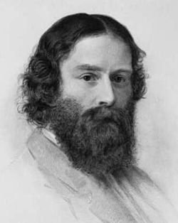
APPLYING JUDGEMENT
True scholarship consists in knowing not what things exist, but what they mean; it is not memory but judgement.
James Russell Lowell, American poet, critic and essayist

Slide 3
SETTING THE CONTEXT
A literature review provides intellectual context for the research in the thesis by systematically:
Describing
Summarising
Evaluating and
Clarifying current thinking in the field
Then synthesising what you have found to create a justification for your project.
It is not a review of the entire field, but of fields related directly to your study.

Slide 4
MARKER OF THESIS QUALITY
According to researchers, examiners form their initial impressions of the quality of your thesis by the time they have finished reading your literature review.
G Mullins and M Kiley (2002). ‘It’s a PhD, not a Nobel Prize’: how experienced examiners assess research theses. Studies in Higher Education, 27 (4), 369-386.

Slide 5
A FORM OF DATA GATHERING
The work you do to create a literature review is not that different to primary data gathering.
The “data”, however, are the research outcomes recorded in the journal articles you are reviewing.
Therefore, you engage in:
Problem formulation
Data collection
Data evaluation
Analysis and interpretation
Public presentation
(List from Justus J Randolph, “A guide to writing a dissertation literature review”, Practical Assessment, Research and Evaluation, Vol. 14 No. 13, June 2009.)

Slide 6


WHAT IS COVERED
“Literature” in this context means the body of published work related to the topic.
Peer-reviewed articles and scholarly books are the dominant forms of literature.
However, government reports, historical records, web-based and multimedia materials may also qualify.

Slide 7
BEGIN EARLY IN YOUR STUDY BECAUSE:
You build knowledge about important concepts, research methods and experimental techniques;
You learn how others have approached or conceptualised your topic;
You gain insight into aspects of your topic that warrant more detailed exploration; and
You learn how research findings are presented and discussed in your discipline.

Slide 8
FINDING SIMILARITIES AND DIFFERENCES
Your literature review will show both:
the consistent themes that run through the relevant texts; and
the divergent viewpoints

Slide 9
IDENTIFYING THE GAPS
Identify areas that have not been sufficiently covered by other researchers.
Into these gaps you will pour your original thinking.
Indicate where your project will fill these gaps and thereby contribute to the discipline.

Slide 10

JUSTIFYING YOUR PROJECT
Justify your project by placing it into the wider field.
The way that you analyse published literature will demonstrate your research skills and your professional competence.

Slide 11
YOUR READER SHOULD DISCOVER:
What specifically your project will look at (position it within existing scholarship);
Why your project will investigate that particular problem (show gaps in existing scholarship and/or demonstrate the need for this research); and
Why your methods/approaches are the best ones to deal with your particular project. (Justify your approach)

Slide 12
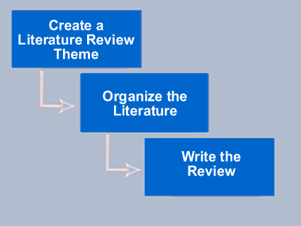
GROUPING INFORMATION
Organise literature into groups
All problem solving involves regrouping data.
Gather information into the main component groups of your project.

Slide 13
USE THE “CASCADE” APPROACH
Think of a working title that best summarises your whole research project.
For example, think about the component parts of a project looking at developing programs to slow down memory loss in aging brains.
Possible title: A new program to slow down memory loss in aging brains.

Slide 14

THINK OF WHAT YOU NEED TO COVER TO FULFIL EXPECTATIONS
The aging brain – what it is, why it declines etc.
The memory process.
Loss of memory.
Loss of memory in aging brains (specifically).
Ways/programs to improve memory loss.

Slide 15
FULFILLING EXPECTATIONS CONTINUED
Methodological problems in developing these kinds of programs.
Existing programs to improve memory loss.
Advantages of existing programs (Blogg’s methods).
Problems with existing programs (gaps) (e.g. Blogg’s method doesn’t work with females).

Slide 16
BEGIN STRUCTURING, THEN WRITING
Divide each section into sub sections and sub-sub sections. Place them into an outline table.
Draft a more detailed outline of each section, sketch out the paragraphs and draft the first few pages.

Slide 17
GAP STATEMENT
At the conclusion of the lit review, you should be able to make a clear statement about a knowledge gap that you can fill:
This study examines ways to develop a new program that will exploit Blogg’s method of transference, but extends his work to the female population.

Slide 18
READ FOR FIRST IMPRESSIONS
When first exploring a new field of research, skim the literature in a strategic way.
At this stage, read only the abstract, introduction and discussion.
Identify the ideas, theories, questions and controversies that underlie each item.

Slide 19
STRATEGIES FOR READING
Take note of the themes or categories you see emerging.
Note how other writers classify their data, the literature in their fields, and so on.
Read other literature reviews in your discipline to see how they are structured.

Slide 20
SOME COMMON PROBLEMS
The review does not clearly relate the findings of the literature review to the researcher’s own study;
The review relies on secondary sources rather than primary sources in reviewing the literature;
The review does not consider contrary findings and alternative interpretations.
(Adapted from Randolph)

Slide 21
STEP BY STEP
Compile all your literature into groups that match your sections/sub-sections.
Outline the review by showing the relationships between items of literature (similarities/contrasts/trends).
Determine the main keywords for each section and place them in the outline. Think about your theme sentences (and how you can use them to start theme sentences).
Read the outline to see if it has flow and logic.
Show the outline to advisor/s for comment.
Draft the review.

Slide 22
SOME QUESTIONS TO ANSWER
What is already known about the area?
What are the characteristics of the key concepts or the main factors or variables?
What are the relationships between these key concepts factors or variables?
What are the existing theories?
What are the inconsistencies or other shortcomings in understanding?

Slide 23
QUESTIONS CONTINUED
What views need to be (further) tested?
What evidence is lacking, inconclusive, contradictory or too limited?
Why study (further) the research problem?
What contribution can your study make?
What research designs or methods seem unsatisfactory?

Slide 24
NOT JUST A LIST…
Write a synthesis and a critique.
You are not just providing evidence of your ability to find the material. You must show that you have understood it and can place it into context.
Draw relationships between the ideas you encounter, rather than just name them.

Slide 25
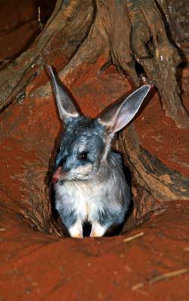
DO NOT DO THIS
Smith (1970) reported that bilbies come out at night and eat chocolates. Jones (1972) described the variety of beetles eaten by bilbies on their daytime trips. Wheeler (1974) reported that bilbies eat only apples.
What conclusion that can be drawn from these facts?
What is the common denominator?

Slide 26
REWRITTEN
The elusive bilby has provoked considerable disagreement over fundamental facts such as whether it is diurnal or nocturnal, and what it eats. While Smith (1970) conducted a highly cited study that showed they were nocturnal, Jones (1972) controversially reported that they were daytime foragers. Although the bilby’s fondness for chocolate was noted by Smith (1970), these findings were rejected by both Jones (1972) and Wheeler (1974). Jones asserted that bilbies ate beetles, while Wheeler presented disputed evidence that apples were the staple food. However, neither chocolate nor apples are indigenous to the bilby habitat, and it seems improbable that they are the main foodstuffs for bilbies.
Eucalyptus leaves, on the other hand, are widely available in the bilby region……

Slide 27
FROM A REAL REVIEW
The higher education literature is divided about the importance of matching students with mentors of the same gender or ethnicity. While much of the descriptive and theoretical literature about mentoring for students of color emphasizes that cross-race or cross-gender relationships can be effective (e.g., Moses, 1989; Pounds, 1987; Rowe, 1989), many programs in practice strive to pair students with a mentor from their own gender or ethnic background (e.g., Meznek, McGrath, & Garcia, 1989; Oestereichen, 1987; cf., Johnson, 1989).
Researchers also disagree about the efficacy of formal mentoring, or programs in which mentors are assigned to students or employees as opposed to those instances in which the mentor relationship is an outcome of mutual attraction and free choice. On the one hand, the proliferation of formal or assigned-mentoring programs in both business and educational settings attests to a widespread belief in their effectiveness (cf., Gerstein, 1985). On the other hand, at least some researchers and practitioners are skeptical. For example, Conrad (1985) concludes, "At least in our culture, where choice is a strongly valued part of relationships, formal arrangements have had only limited success" (p. 300). (Also see Noe, 1988b.) Given the wide variety of formal mentoring programs coupled with the paucity of well-designed evaluation research, speculation about this issue is all that is available at this time.
From Maryann Jacobi, “Mentoring and Undergraduate Academic Success: A Literature Review”, Review of Educational Research, 1991, 61: 505.

Slide 28
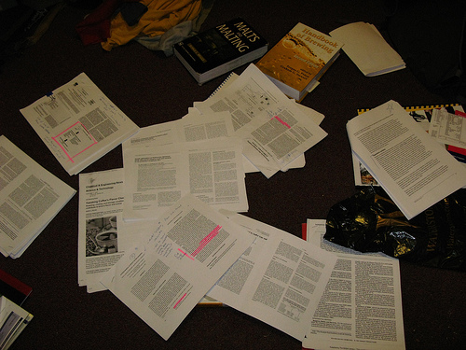
CLASSIFY YOUR INFORMATION
Classify information based on key words or ideas relevant to your research question.
Before you begin reading, try to foresee categories, themes or key words.
If you see that several sources comment on the same idea, make note of this.

Slide 29
TIPS FOR READING DIFFICULT MATERIAL
Start with what is written about your topic in more popular or accessible journals;
Build up a glossary of unfamiliar terms and definitions;
Read the intro and conclusion first, before attempting to read the methods or results;

Slide 30
TIPS CONTINUED
Skim the main sections of the article to gain a sense of scope, purpose and themes before attempting a sentence-by-sentence reading;
Return to difficult materials after reading other authors on the topic - extend your understanding through parallel reading.

Slide 31
WRITING TIPS
Develop an extensive, nuanced and flexible vocabulary by reading widely in your field.
Use concise, eloquent and grammatically correct sentences for maximum persuasiveness.

Slide 32
WRITING TIPS CONTINUED
Try to use key words to begin sentences.
Vary sentence and paragraph length.
Use short sentences for theme sentences (no more than 25 words).
Use sub-headings to break up text and introduce new themes or ideas.
Use boxed text to introduce case studies or additional information.

Slide 33
DRAFT AND REDRAFT
Through the drafting process, you will refine your writing and also greatly increase your understanding.
As we discussed in Week 1, carry out a four-stage drafting process for your literature review (or more if necessary).
Polish your work to a high standard.

Slide 34
FROM GENERAL TO SPECIFIC
Find expressions to move from the general to the specific or vice-versa:
For example: Contrary to patterns of gendered behaviour in Australia generally, women of the x region typically …
Compare national patterns with local patterns.
Compare a national trend with the trend in your findings.
Compare global patterns with your findings.

Slide 35
DEFINING YOUR TERMS
You may need to define and differentiate between key terms.
Within your discipline key terms may be used differently; be explicit about how you are using them.
Refer to the ways these terms are used by other writers.

Slide 36
FOR EXAMPLE
Use of terminology in the literature on competence is ambiguous and confusing, with terms such as competence, competency, capability and performance being used inconsistently and often interchangeably. There appears to be a distinct difference between the meanings of competence and competency (Manley & Garbett 2000). Competence and competences are job-related, being a description of an action, behaviour or outcome that a person should demonstrate in their performance. Competency and competencies, on the other hand, are person-orientated, referring to the person's underlying characteristics and qualities that lead to an effective and/or superior performance in a job. According to Woodruffe (1993), competence is aspects of the job that an individual can perform, while competency is an individual's behaviour underpinning competent performance. In their original uses these terms are specific to particular models or approaches to the topic but usage has become blurred over time.
From McMullan et al, “Portfolios and assessment of competence: a review of the literature”

Slide 37
DEVELOPING KEY TERMS 1
Demonstrate your specific use of a term or phrase:
I take x to mean … Not in the common sense of the word which is…
I follow the Oxford dictionary meaning of y.
I have adopted Nurk’s use of x to connote …
Despite the recent proliferation of the use of the term x in the media to mean a, I follow Bloggs’ use of the term to mean b.

Slide 38
DEVELOPING KEY TERMS 2
In this case, I use the term ‘x’ to mean …
The use of the term x does not imply y.
There is some debate about the application of the term x in the discipline of y. I follow those writers who assert its use in contexts where z applies.

Slide 39
USE DIRECT QUOTES SPARINGLY
The use of direct quotes can be problematic, particularly if they are not used well. For example:
Studies of the Baltimore butterfly (Euphydryas phaeton) showed that “larvae occupied communal nests of various sizes” and “commonly cannibalized in hatched eggs in the same colony’ (Monto 1950). “In both field and laboratory tests, there was a higher incidence of cannibalism by larvae occupying large colonies” (Monto 1950). Also, “cannibalistic acts occurred at a higher frequency under conditions of food shortage” when the larval foodplant, turtlehead, “was in short supply or extensively defoliated’ (Mulry 1960).

Slide 40
REWRITTEN
Studies of the Baltimore butterfly (Euphydryas phaeton) showed that cannibalism of eggs by the communal larvae was more frequent in large colonies than in small ones (Monti 1959). Cannibalism also increased when the larval foodplant, turtlehead, was scarce (Mulry 1960). etc

Slide 41
CHECKLIST: SELECTION OF SOURCES
Have you indicated the purpose of the review?
Are the parameters of the review reasonable?
Have you explained why you included some literature and excluded others?
Have you emphasised recent developments?
Have you focused on primary sources with only selective use of secondary sources?
Is the literature you have selected relevant?
Is your bibliographic data complete?

Slide 42
CHECKLIST: CRITICAL EVALUATION
Is the material organised logically?
Does the amount of detail included on an issue relate to its importance?
Have you been sufficiently critical of design and methodological issues?
Have you indicated when results were conflicting or inconclusive and discussed possible reasons?
Have you indicated the relevance of each reference to your research?

Slide 43
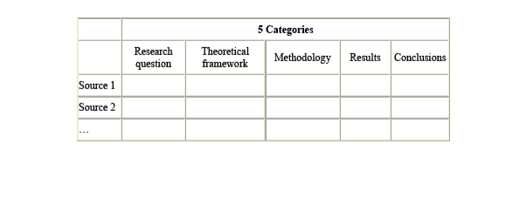
ORGANISING INFORMATION

Slide 44
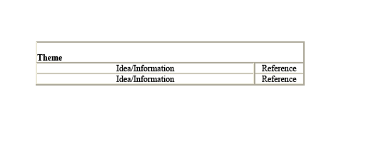
CLASSIFICATION BY THEME

Slide 45
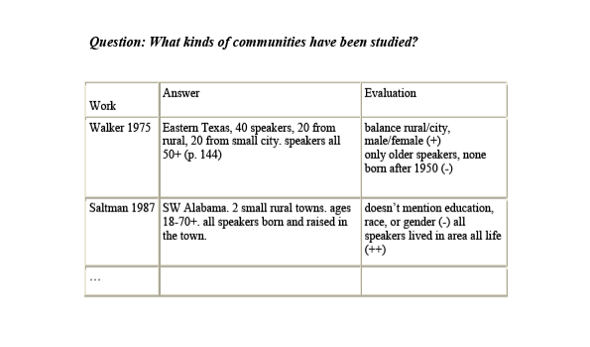
QUESTION-DRIVEN LIST

Slide 46
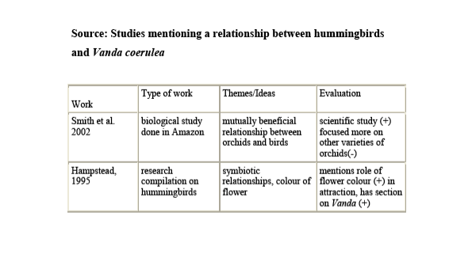
SOURCE-DRIVEN LIST

Slide 47
VIEW YOUR GRIDS AND ASK QUESTIONS ABOUT RELATIVE IMPORTANCE
Which sources are mentioned repeatedly by several authors?
Are these the leading sources in the field?
Are they the most recent sources?
What sources answer your questions most effectively?
Least effectively?
Create hierarchies of information from the literature and discuss this in your review.

Slide 48
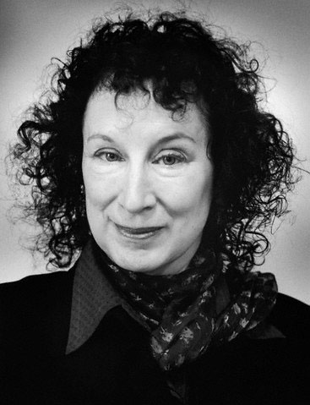
A FINAL THOUGHT…
The answers you get from literature depend on the questions you pose.
Margaret Atwood, Canadian author

